Slide 1
Module 17: Transactions

Slide 2
Outline
Transaction Concept
Transaction State
Concurrent Executions
Serializability
Recoverability
Implementation of Isolation
Transaction Definition in SQL
Testing for Serializability.

Slide 3
Transaction Concept
A transaction is a unit of program execution that accesses and possibly updates various data items.
E.g., transaction to transfer $50 from account A to account B:
1. read(A)
2. A := A – 50
3. write(A)
4. read(B)
5. B := B + 50
6. write(B)
Two main issues to deal with:
Failures of various kinds, such as hardware failures and system crashes
Concurrent execution of multiple transactions

Slide 4
Example of Fund Transfer
Transaction to transfer $50 from account A to account B. t=0, A=B=100
1. read(A)
2. A := A – 50
3. write(A)
4. read(B)
5. B := B + 50
6. write(B)
Atomicity requirement
If the transaction fails after step 3 and before step 6, money will be “lost” leading to an inconsistent database state
Failure could be due to software or hardware
The system should ensure that updates of a partially executed transaction are not reflected in the database
Durability requirement — once the user has been notified that the transaction has completed (i.e., the transfer of the $50 has taken place), the updates to the database by the transaction must persist even if there are software or hardware failures.

Slide 5
Example of Fund Transfer (Cont.)
Consistency requirement in above example:
The sum of A and B is unchanged by the execution of the transaction (A+B=200)
In general, consistency requirements include
Explicitly specified integrity constraints such as primary keys and foreign keys
Implicit integrity constraints
e.g., sum of balances of all accounts, minus sum of loan amounts must equal value of cash-in-hand
A transaction must see a consistent database.
During transaction execution the database may be temporarily inconsistent.
When the transaction completes successfully the database must be consistent
Erroneous transaction logic can lead to inconsistency

Slide 6
Example of Fund Transfer (Cont.)
Isolation requirement — if between steps 3 and 6, another transaction T2 is allowed to access the partially updated database, it will see an inconsistent database (the sum A + B will be less than it should be).
T1 T2
1. read(A)
2. A := A – 50
3. write(A) read(A), read(B), print(A+B)
4. read(B)
5. B := B + 50
6. write(B
Isolation can be ensured trivially by running transactions serially
That is, one after the other.
However, executing multiple transactions concurrently has significant benefits, as we will see later.

Slide 7
ACID Properties
A transaction is a unit of program execution that accesses and possibly updates various data items. To preserve the integrity of data the database system must ensure:
Atomicity. Either all operations of the transaction are properly reflected in the database or none are.
Consistency. Execution of a transaction in isolation preserves the consistency of the database.
Isolation. Although multiple transactions may execute concurrently, each transaction must be unaware of other concurrently executing transactions. Intermediate transaction results must be hidden from other concurrently executed transactions.
That is, for every pair of transactions T_{i} and T_{j}, it appears to T_{i} that either T_{j}, finished execution before T_{i} started, or T_{j} started execution after T_{i} finished.
Durability. After a transaction completes successfully, the changes it has made to the database persist, even if there are system failures.

Slide 8
Transaction State
Active – the initial state; the transaction stays in this state while it is executing
Partially committed – after the final statement has been executed.
Failed -- after the discovery that normal execution can no longer proceed.
Aborted – after the transaction has been rolled back and the database restored to its state prior to the start of the transaction. Two options after it has been aborted:
Restart the transaction
Can be done only if no internal logical error
Kill the transaction
Committed – after successful completion.

Slide 9
Transaction State (Cont.)

Slide 10
Concurrent Executions
Multiple transactions are allowed to run concurrently in the system. Advantages are:
Increased processor and disk utilization, leading to better transaction throughput
E.g., one transaction can be using the CPU while another is reading from or writing to the disk
Reduced average response time for transactions: short transactions need not wait behind long ones.
Concurrency control schemes – mechanisms to achieve isolation
That is, to control the interaction among the concurrent transactions in order to prevent them from destroying the consistency of the database

Slide 11
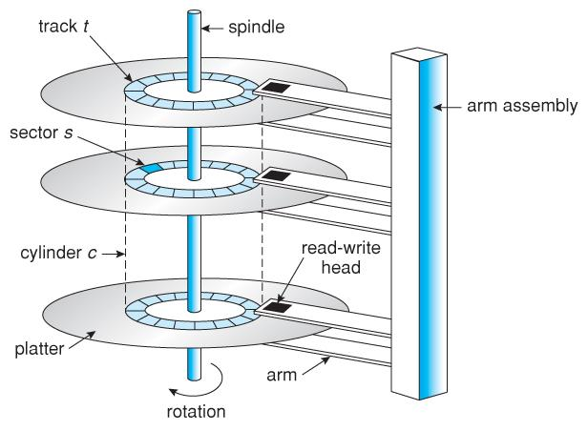
Disk Structure [1]
Figure 3. Disk Structure
[1] http://casem3.blogspot.com/2016/10/magnetic-disk-primary-computer-storage.html
Notes:
1

Slide 12
Schedules
Schedule – a sequences of instructions that specify the chronological order in which instructions of concurrent transactions are executed
A schedule for a set of transactions must consist of all instructions of those transactions
Must preserve the order in which the instructions appear in each individual transaction.
A transaction that successfully completes its execution will have a commit instructions as the last statement
By default transaction assumed to execute commit instruction as its last step
A transaction that fails to successfully complete its execution will have an abort instruction as the last statement

Slide 13
Schedule 1
Let T₁ transfer $50 from A to B, and T₂ transfer 10% of the balance from A to B.
At t=0, A=B=100, A+B= 200, A=45, B=155
A serial schedule in which T₁ is followed by T₂ :

Slide 14
Schedule 2
A serial schedule where T₂ is followed by T₁
At t=0, A=B=100, A+B= 200, A=40, B=160

Slide 15
Schedule 3
Let T₁ and T₂ be the transactions defined previously. The following schedule is not a serial schedule, but it is equivalent to Schedule 1
In Schedules 1, 2 and 3, the sum A + B is preserved.

Slide 16
Schedule 4
The following concurrent schedule does not preserve the value of (A + B )
.

Slide 17
Serializability
Basic Assumption – Each transaction preserves database consistency.
Thus, serial execution of a set of transactions preserves database consistency.
A (possibly concurrent) schedule is serializable if it is equivalent to a serial schedule. Different forms of schedule equivalence give rise to the notions of:
1. Conflict serializability
2. View serializability

Slide 18
Simplified view of transactions
We ignore operations other than read and write instructions
We assume that transactions may perform arbitrary computations on data in local buffers in between reads and writes.
Our simplified schedules consist of only read and write instructions.
read(X), which transfers the data item X from the database to a variable, also called X, in a buffer in main memory belonging to the transaction that executed the read operation.
• write(X), which transfers the value in the variable X in the main-memory buffer of the transaction that executed the write to the data item X in the database.

Slide 19
Conflicting Instructions
Instructions l_{i} and l_{j} of transactions T_{i} and T_{j} respectively, conflict if and only if there exists some item Q accessed by both l_{i} and l_{j}, and at least one of these instructions wrote Q.
1. l_{i} = read(Q), l_{j} = read(Q). l_{i} and l_{j} don’t conflict. 2. l_{i} = read(Q), l_{j} = write(Q). They conflict. 3. l_{i} = write(Q), l_{j} = read(Q). They conflict 4. l_{i} = write(Q), l_{j} = write(Q). They conflict
Intuitively, a conflict between l_{i} and l_{j} forces a (logical) temporal order between them.
If l_{i} and l_{j} are consecutive in a schedule and they do not conflict, their results would remain the same even if they had been interchanged in the schedule.

Slide 20
Conflict Serializability
If a schedule S can be transformed into a schedule S’ by a series of swaps of non-conflicting instructions, we say that S and S’ are conflict equivalent.
We say that a schedule S is conflict serializable if it is conflict equivalent to a serial schedule

Slide 21
Conflict Serializability (Cont.)
Schedule 3 can be transformed into Schedule 6, a serial schedule where T₂ follows T₁, by series of swaps of non-conflicting instructions. Therefore Schedule 3 is conflict serializable.
Schedule 3
Schedule 6

Slide 22
Conflict Serializability (Cont.)
Example of a schedule that is not conflict serializable:
We are unable to swap instructions in the above schedule to obtain either the serial schedule < T₃, T₄ >, or the serial schedule < T₄, T₃ >.

Slide 23
View Serializability
Let S and S’ be two schedules with the same set of transactions. S and S’ are view equivalent if the following three conditions are met, for each data item Q,
1. If in schedule S, transaction T_{i} reads the initial value of Q, then in
schedule S’ also transaction T_{i} must read the initial value of Q.
2. If in schedule S transaction T_{i} executes read(Q), and that value was
produced by transaction T_{j} (if any), then in schedule S’ also
transaction T_{i} must read the value of Q that was produced by the
same write(Q) operation of transaction T_{j} .
3. The transaction (if any) that performs the final write(Q) operation in
schedule S must also perform the final write(Q) operation in schedule S’.
As can be seen, view equivalence is also based purely on reads and writes alone.

Slide 24
View Serializability (Cont.)
A schedule S is view serializable if it is view equivalent to a serial schedule.
Every conflict serializable schedule is also view serializable.
Below is a schedule which is view-serializable but not conflict serializable.
What serial schedule is above equivalent to?
Every view serializable schedule that is not conflict serializable has blind writes.

Slide 25
Other Notions of Serializability
The schedule below produces same outcome as the serial schedule < T₁, T₅ >, yet is not conflict equivalent or view equivalent to it.
Determining such equivalence requires analysis of operations other than read and write.

Slide 26
Testing for Serializability
Consider some schedule of a set of transactions T₁, T₂, ..., T_{n}
Precedence graph — a direct graph where the vertices are the transactions (names).
We draw an arc from T_{i} to T_{j} if the two transaction conflict, and T_{i} accessed the data item on which the conflict arose earlier.
We may label the arc by the item that was accessed.
Example of a precedence graph

Slide 27
Example
A schedule that is not conflict serializable:
One node per Xact; edge from Ti to Tj if actions of Ti precedes and conflicts with one of Tj’s actions
The cycle in the graph G (V,E) reveals the problem. The output of T1 depends on T2, and vice-versa
Schedule is conflict serializable if and only if its precedence graph is acyclic
T1: R(A), W(A), R(B), W(B)
T2: R(A), W(A), R(B), W(B)
A
T1
T2
B

Slide 28
Test for Conflict Serializability
A schedule is conflict serializable if and only if its precedence graph is acyclic.
Cycle-detection algorithms exist which take order n² time, where n is the number of vertices in the graph.
(Better algorithms take order n + e where e is the number of edges.)
If precedence graph is acyclic, the serializability order can be obtained by a topological sorting of the graph.
This is a linear order consistent with the partial order of the graph.
For example, a serializability order for Schedule A would be T₅ → T₁ → T₃ → T₂ → T₄
Are there others?

Slide 29
Test for View Serializability
The precedence graph test for conflict serializability cannot be used directly to test for view serializability.
Extension to test for view serializability has cost exponential in the size of the precedence graph.
The problem of checking if a schedule is view serializable falls in the class of NP-complete problems.
Thus, existence of an efficient algorithm is extremely unlikely.
However practical algorithms that just check some sufficient conditions for view serializability can still be used.

Slide 30
Recoverable Schedules
Need to address the effect of transaction failures on concurrently running transactions.
Recoverable schedule — if a transaction T_{j} reads a data item previously written by a transaction T_{i} , then the commit operation of T_{i} appears before the commit operation of T_{j}.
The following schedule (Schedule 11) is not recoverable
If T₈ should abort, T₉ would have read (and possibly shown to the user) an inconsistent database state. Hence, database must ensure that schedules are recoverable.

Slide 31
Cascading Rollbacks
Cascading rollback – a single transaction failure leads to a series of transaction rollbacks. Consider the following schedule where none of the transactions has yet committed (so the schedule is recoverable) If T₁₀ fails, T₁₁ and T₁₂ must also be rolled back.
Can lead to the undoing of a significant amount of work

Slide 32
Cascadeless Schedules
Cascadeless schedules — cascading rollbacks cannot occur;
For each pair of transactions T_{i} and T_{j} such that T_{j} reads a data item previously written by T_{i}, the commit operation of T_{i} appears before the read operation of T_{j}.
Every Cascadeless schedule is also recoverable
It is desirable to restrict the schedules to those that are cascadeless

Slide 33
Concurrency Control
A database must provide a mechanism that will ensure that all possible schedules are
serializable, and
are recoverable and preferably cascadeless
A policy in which only one transaction can execute at a time generates serial schedules, but provides a poor degree of concurrency
Are serial schedules recoverable/cascadeless?
Testing a schedule for serializability after it has executed is a little too late!
Goal – to develop concurrency control protocols that will assure serializability.

Slide 34
Concurrency Control
A policy in which only one transaction can execute at a time generates serial schedules, but provides a poor degree of concurrency.
Concurrency-control schemes tradeoff between the amount of concurrency they allow and the amount of overhead that they incur.

Slide 35
Concurrency Control Protocols
Lock-Based Protocols
Timestamp-Based Protocols
Validation-Based Protocols
Multiple Granularity
Multiversion Schemes
Insert and Delete Operations
Concurrency in Index Structures

Slide 36
Lock Based CC
Only serializable, recoverable schedules are allowed, no actions of committed transactions are lost while undoing aborted transactions
Use of locks
Locking protocol is a set of rules to be followed by each transaction to ensure that net effect of interleaved transactions is identical to some serial execution

Slide 37
Lock-Based Protocols
A lock is a mechanism to control concurrent access to a data item
Data items can be locked in two modes :
1. exclusive (X) mode. Data item can be both read as well as
written. X-lock is requested using lock-X instruction.
2. shared (S) mode. Data item can only be read. S-lock is
requested using lock-S instruction.
Lock requests are made to concurrency-control manager. Transaction can proceed only after request is granted.

Slide 38
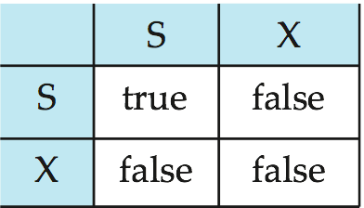
Lock-Based Protocols
Lock-compatibility matrix
A transaction may be granted a lock on an item if the requested lock is compatible with locks already held on the item by other transactions.
Any number of transactions can hold shared locks on an item,
but if any transaction holds an exclusive lock on the item no other transaction may hold any lock on the item.
If a lock cannot be granted, the requesting transaction is made to wait till all incompatible locks held by other transactions have been released. The lock is then granted.
Notes:
38

Slide 39
Lock-Based Protocols
Example of a transaction performing locking:
T₂: lock-S(A);
read (A);
unlock(A);
lock-S(B);
read (B);
unlock(B);
display(A+B)
Locking as above is not sufficient to guarantee serializability — if A and B get updated in-between the read of A and B, the displayed sum would be wrong.
A locking protocol is a set of rules followed by all transactions while requesting and releasing locks. Locking protocols restrict the set of possible schedules.
Notes:
39

Slide 40
Lock-Based Protocols (Cont.)
Example of a transaction performing locking:
T₂: lock-S(A);
read (A);
unlock(A);
lock-S(B);
read (B);
unlock(B);
display(A+B)
Locking as above is not sufficient to guarantee serializability

Slide 41
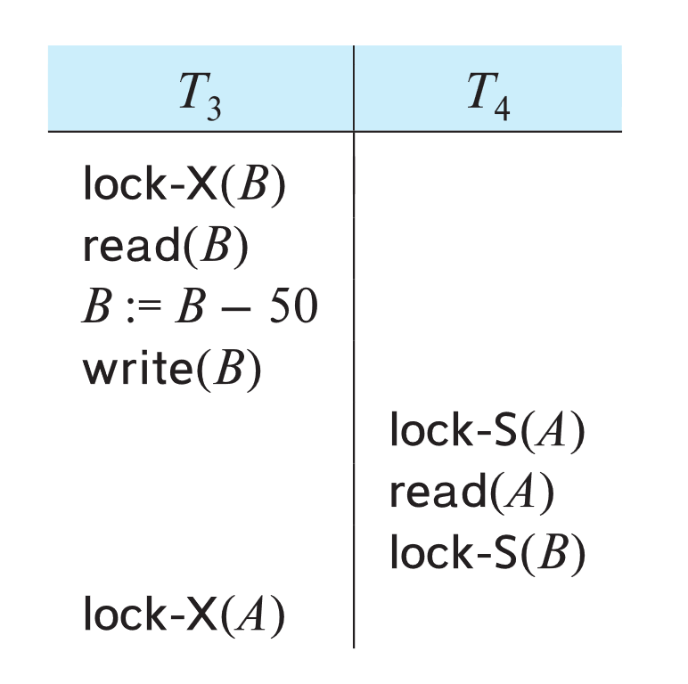
Deadlock
Consider the partial schedule
Neither T₃ nor T₄ can make progress — executing lock-S(B) causes T₄ to wait for T₃ to release its lock on B, while executing lock-X(A) causes T₃ to wait for T₄ to release its lock on A.
Two-phase locking does not ensure freedom from deadlock. Observe that transactions
T3 and T4 are two phase
Such a situation is called a deadlock.
To handle a deadlock one of T₃ or T₄ must be rolled back and its locks released.

Slide 42
Deadlock (Cont.)
The potential for deadlock exists in most locking protocols. Deadlocks are a necessary evil.
Starvation is also possible if concurrency control manager is badly designed. For example:
A transaction may be waiting for an X-lock on an item, while a sequence of other transactions request and are granted an S-lock on the same item.
The same transaction is repeatedly rolled back due to deadlocks.
Concurrency control manager can be designed to prevent starvation.

Slide 43
The Two-Phase Locking Protocol
A protocol which ensures conflict-serializable schedules.
Phase 1: Growing Phase
Transaction may obtain locks
Transaction may not release locks
Phase 2: Shrinking Phase
Transaction may release locks
Transaction may not obtain locks
The protocol assures serializability. It can be proved that the transactions can be serialized in the order of their lock points (i.e., the point where a transaction acquired its final lock).
Locks
Time

Slide 44
The Two-Phase Locking Protocols
Two-phase locking does not ensure freedom from deadlocks.
Cascading roll-back is possible under two-phase locking. To avoid this, follow a modified protocol called strict two-phase locking. Here a transaction must hold all its exclusive locks till it commits/aborts.
Rigorous two-phase locking is even stricter: here all locks are held till commit/abort. In this protocol transactions can be serialized in the order in which they commit.
Notes:
44

Slide 45
The Two-Phase Locking Protocols (Cont.)
Two-phase locking does not ensure freedom from deadlocks
Extensions to basic two-phase locking needed to ensure recoverability of freedom from cascading roll-back
Strict two-phase locking: a transaction must hold all its exclusive locks till it commits/aborts.
Ensures recoverability and avoids cascading roll-backs
Rigorous two-phase locking/ Two-phase locking: a transaction must hold all locks till commit/abort.
Transactions can be serialized in the order in which they commit.
Most databases implement rigorous two-phase locking, but refer to it as simply two-phase locking

Slide 46
Locking in Commercial Databases
When a transaction Ti issues a read(Q) operation, the system issues a lock-S(Q)
instruction followed by the read(Q) instruction.
When Ti issues a write(Q) operation, the system checks to see whether Ti already
holds a shared lock on Q. If it does, then the system issues an upgrade(Q) instruction, followed by the write(Q) instruction. Otherwise, the system issues a
lock-X(Q) instruction, followed by the write(Q) instruction.
All locks obtained by a transaction are unlocked after that transaction commits or aborts.

Slide 47
Lock Management
Lock and unlock requests are handled by the lock manager
Maintains Lock table entry:
Number of transactions currently holding a lock
Type of lock held (shared or exclusive)
Pointer to queue of lock requests
Locking and unlocking have to be atomic operations
Lock upgrade: transaction that holds a shared lock can be upgraded to hold an exclusive lock
Descriptive entry in transaction table for each transaction
Entry contains pointer to a list of locks held by the transaction
This list is checked before requesting a lock to ensure that a transaction does not request the same lock twice

Slide 48
Concurrency Control vs. Serializability Tests
Concurrency-control protocols allow concurrent schedules, but ensure that the schedules are conflict/view serializable, and are recoverable and cascadeless .
Different concurrency control protocols provide different tradeoffs between the amount of concurrency they allow and the amount of overhead that they incur.

Slide 49
Weak Levels of Consistency
Some applications are willing to live with weak levels of consistency, allowing schedules that are not serializable
E.g., a read-only transaction that wants to get an approximate total balance of all accounts
E.g., database statistics computed for query optimization can be approximate
Such transactions need not be serializable with respect to other transactions
Tradeoff accuracy for performance

Slide 50
Levels of Consistency
Lower degrees of consistency useful for gathering approximate information about the database
Warning: some database systems do not ensure serializable schedules by default
E.g., Oracle (and PostgreSQL prior to version 9) by default support a level of consistency called snapshot isolation (not part of the SQL standard)

Slide 51
Pitfalls of Lock-Based Protocols
Starvation is also possible if concurrency control manager is badly designed. For example:
A transaction may be waiting for an X-lock on an item, while a sequence of other transactions request and are granted an S-lock on the same item.
The same transaction is repeatedly rolled back due to deadlocks.
Concurrency control manager can be designed to prevent starvation.
Notes:
51

Slide 52
Deadlocks
Deadlock: Cycle of transactions waiting for locks to be released by each other.
Two ways of dealing with deadlocks:
Deadlock prevention
Deadlock detection
Identification of deadlocks using timeout mechanism: transaction waiting for too long…assuming it is a deadlock …abort it
Blocking : blocked transactions may hold other locks that force other transactions to wait
Aborting and restarting: wastes the work done

Slide 53
Deadlock prevention
protocols ensure that the system will never enter into a deadlock state. Some prevention strategies:
Require that each transaction locks all its data items before it begins execution (predeclaration).
Impose partial ordering of all data items and require that a transaction can lock data items only in the order specified by the partial order (graph-based protocol).

Slide 54
Deadlock Prevention Strategies
Following schemes use transaction timestamps for the sake of deadlock prevention alone.
TS(T1) < TS (T2)
wait-die scheme —
older transaction may wait for younger one to release data item. Younger transactions never wait for older ones; they are rolled back instead.
a transaction may die several times before acquiring needed data item
wound-wait scheme —
older transaction wounds (forces rollback of) younger transaction instead of waiting for it. Younger transactions may wait for older ones.
may be fewer rollbacks than wait-die scheme
Notes:
54

Slide 55
Deadlock Prevention
Assign priorities based on timestamps. Assume Ti wants a lock that Tj holds. Two policies are possible:
Wait-Die: It Ti has higher priority, Ti waits for Tj; otherwise Ti aborts
Wound-wait: If Ti has higher priority, Tj aborts; otherwise Ti waits
Fewer rollbacks in wound-wait
If a transaction re-starts, make sure it has its original timestamp

Slide 56
Wait-Die
Lower the timestamp, higher the priority
If Ti has higher priority, Ti waits for Tj; otherwise Ti aborts
Lower priority transactions can never wait for higher priority transactions
To ensure that no transaction is repeatedly aborted, when a transaction is aborted and hence restarted, it will be given the original timestamp it had
Only a transaction requesting a lock can be aborted
As the transaction grows older, it tends to wait for more and more younger transactions. The conflicting younger transaction may be repeatedly aborted. But a transaction having all the locks will never be aborted.

Slide 57
Wound-Wait
If Ti has higher priority, Tj aborts; otherwise Ti waits
A transaction that has all the locks it needs may get aborted

Slide 58
Deadlock prevention
Both in wait-die and in wound-wait schemes, a rolled back transactions is restarted with its original timestamp. Older transactions thus have precedence over newer ones, thus starvation is avoided
Timeout-Based Schemes:
a transaction waits for a lock only for a specified amount of time. After that, the wait times out and the transaction is rolled back.
thus deadlocks are not possible
simple to implement; but starvation is possible. Also difficult to determine good value of the timeout interval.
Notes:
58

Slide 59
Deadlock Detection
Create a wait-for graph:
Nodes are transactions
There is an edge from Ti to Tj if Ti is waiting for Tj to release a lock
Periodically check for cycles in the waits-for graph

Slide 60
Schedule
T1: S(A), R(A), S(B)
T2: X(B),W(B) X(C)
T3: S(C), R(C) X(A)
T4: X(B)
S1(A), R1(A), X2(B), S1(B),W2(B), S3(C),R3(C), X2(C), X4(B), X3(A)

Slide 61
Deadlock Detection (Continued)
Example:
T1: S(A), R(A), S(B)
T2: X(B),W(B) X(C)
T3: S(C), R(C) X(A)
T4: X(B)
T1
T2
T1
T2
T4
T3
T3
T3

Slide 62
Deadlock Detection
Deadlocks can be described as a wait-for graph, which consists of a pair G = (V,E),
V is a set of vertices (all the transactions in the system)
E is a set of edges; each element is an ordered pair T_{i} →T_{j}.
If T_{i} → T_{j} is in E, then there is a directed edge from T_{i} to T_{j}, implying that T_{i} is waiting for T_{j} to release a data item.
When T_{i} requests a data item currently being held by T_{j}, then the edge T_{i} T_{j} is inserted in the wait-for graph. This edge is removed only when T_{j} is no longer holding a data item needed by T_{i}.
The system is in a deadlock state if and only if the wait-for graph has a cycle. Must invoke a deadlock-detection algorithm periodically to look for cycles.
Notes:
62

Slide 63
Deadlock Recovery
When deadlock is detected: Selection of victim, rollback, starvation
Selection of victim: Some transaction will have to be rolled back (made a victim) to break deadlock. Select that transaction as victim that will incur minimum cost.
How long it has computed and how long is still to go?
Number of data items already used by it
Number of data items to be used further by it
Number of transactions involved in rollback
Notes:
63

Slide 64
Deadlock Recovery
Rollback -- determine how far to roll back transaction
Total rollback: Abort the transaction and then restart it.
Partial rollback: More effective to roll back transaction only as far as necessary to break deadlock.
Needs to keep additional information like state of all running ,
sequence of lock request/grants and updates performed by
transactions
Detection mechanism should decide which locks the selected
transactions needs to release to break the deadlock
The selected transaction must be rolled back to the point where it obtained first of these locks, undoing all actions it took after that
point
Starvation
happens if same transaction is always chosen as victim.
Include the number of rollbacks in the cost factor to avoid starvation

Slide 65
Multiple Granularity
Allow data items to be of various sizes and define a hierarchy of data granularities, where the small granularities are nested within larger ones.
Can be represented graphically as a tree (but don't confuse with tree-locking protocol)
When a transaction locks a node in the tree explicitly, it implicitly locks all the node's descendents in the same mode.
Granularity of locking (level in tree where locking is done):
fine granularity (lower in tree): high concurrency, high locking overhead
coarse granularity (higher in tree): low locking overhead, low concurrency
Notes:
65

Slide 66
Granularity
Data items are of various sizes
Defining hierarchy of data granularities where small granularities are nested within larger ones
Tree
A nonleaf node of multi granularity tree represents data associated with its descendants

Slide 67
Multiple-Granularity Locks
Hard to decide what granularity to lock (tuples vs. pages vs. tables).
Shouldn’t have to decide!
Data “containers” are nested:
Database
contains
Files
Pages
Tuples

Slide 68
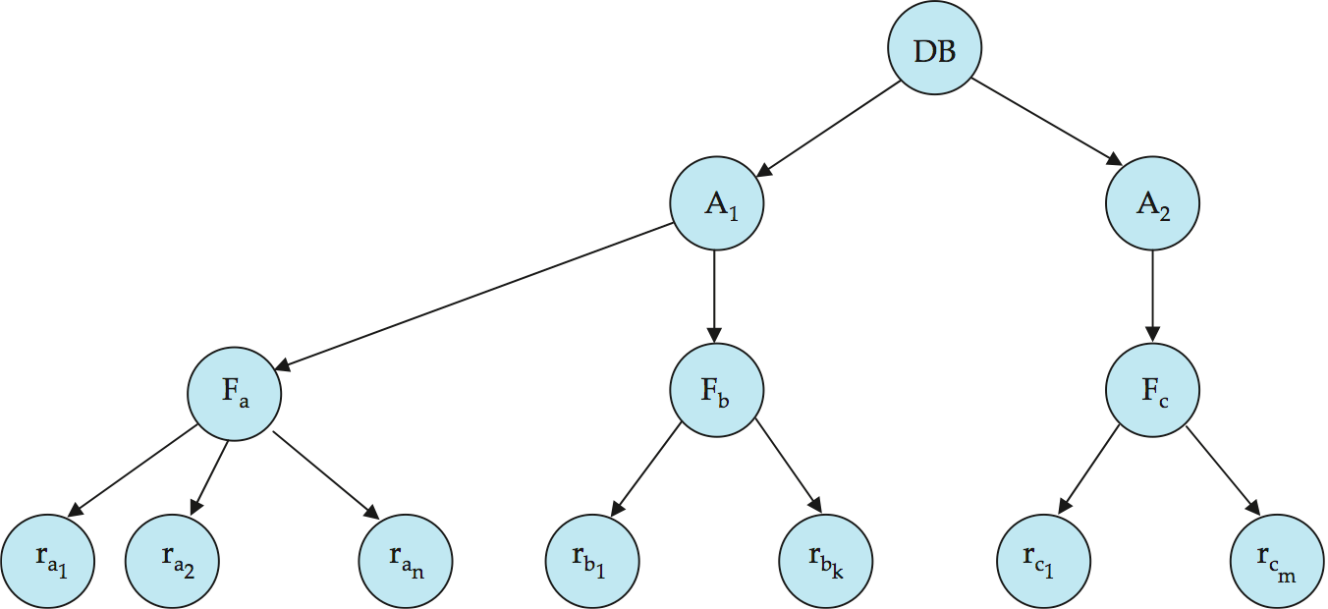
Example of Granularity Hierarchy
The levels, starting from the coarsest (top) level are:
database
file
record
Notes:
68

Slide 69
Writer Starvation Problem
If several READ requests are compatible, immediately grant the lock request. Such policy may cause writer starvation problem if there are a large number of read requests. If a reader was granted a read lock, then fellow readers can immediately join in. However, writers will be blocked out, until all readers have finished. In fact, some unlucky writers may get blocked indefinitely.
A solution is to use FIFO (first in, first out) policy to queue up the requests. Only requests at the front of the queue can try to get the lock. However, concurrency and efficiency may be negatively impacted. Some opportunities for parallel access will be lost as queue processing is serial in nature.

Slide 70
Optimistic CC
Locking is a conservative approach in which conflicts are prevented. Disadvantages:
Lock management overhead
Deadlock detection/resolution
Lock contention for heavily used objects
If conflicts are rare, we might be able to gain concurrency by not locking, and instead checking for conflicts before the transaction commits

Slide 71
Timestamp-Based Protocols
Each transaction is issued a timestamp when it enters the system. If an old transaction T_{i} has time-stamp TS(T_{i}), a new transaction T_{j} is assigned time-stamp TS(T_{j}) such that TS(T_{i}) <TS(T_{j}).
The protocol manages concurrent execution such that the time-stamps determine the serializability order.
In order to assure such behavior, the protocol maintains for each data Q two timestamp values:
W-timestamp(Q) is the largest time-stamp of any transaction that executed write(Q) successfully.
R-timestamp(Q) is the largest time-stamp of any transaction that executed read(Q) successfully.
Notes:
71

Slide 72
Timestamp-Based Protocols (Cont.)
The timestamp ordering protocol ensures that any conflicting read and write operations are executed in timestamp order.
Suppose a transaction T_{i} issues a read(Q):
If TS(T_{i}) ≤ W-timestamp(Q), then T_{i} needs to read a value of Q that was already overwritten.
Hence, the read operation is rejected, and T_{i} is rolled back.
If TS(T_{i})≥ W-timestamp(Q), then the read operation is executed, and R-timestamp(Q) is set to max(R-timestamp(Q), TS(T_{i})).
Notes:
72

Slide 73
Timestamp-Based Protocols (Cont.)
Suppose that transaction T_{i} issues write (Q).
If TS(T_{i}) < R-timestamp (Q), then the value of Q that T_{i} is producing was needed previously, and the system assumed that that value would never be produced.
Hence, the write operation is rejected, and T_{i} is rolled back.
If TS(T_{i}) < W-timestamp (Q), then T_{i} is attempting to write an obsolete value of Q.
Hence, this write operation is rejected, and T_{i} is rolled back.
Otherwise, the write operation is executed, and W-timestamp(Q) is set to TS(T_{i}).
Notes:
73

Slide 74
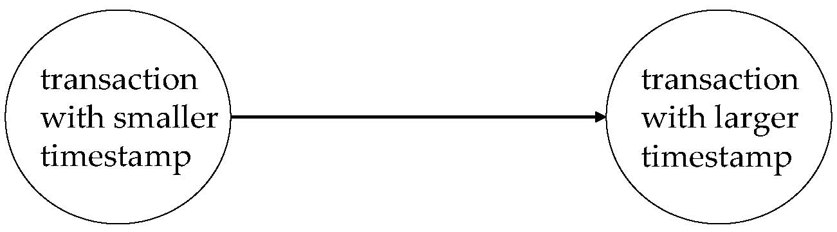
Correctness of Timestamp-Ordering Protocol
The timestamp-ordering protocol guarantees serializability since all the arcs in the precedence graph are of the form:
Thus, there will be no cycles in the precedence graph.
Timestamp protocol ensures freedom from deadlock as no transaction ever waits.
But the schedule may not be cascade-free, and may not even be recoverable.
Notes:
74

Slide 75
Recoverability and Cascade Freedom
Problem with timestamp-ordering protocol:
Suppose T_{i} aborts, but T_{j} has read a data item written by T_{i}
Then T_{j} must abort; if T_{j} had been allowed to commit earlier, the schedule is not recoverable.
Further, any transaction that has read a data item written by T_{j} must abort
This can lead to cascading rollback --- that is, a chain of rollbacks
Solution 1:
A transaction is structured such that its writes are all performed at the end of its processing
All writes of a transaction form an atomic action; no transaction may execute while a transaction is being written
A transaction that aborts is restarted with a new timestamp
Solution 2: Limited form of locking: wait for data to be committed before reading it
Solution 3: Use commit dependencies to ensure recoverability
Notes:
75

Slide 76
Thomas’ Write Rule
Modified version of the timestamp-ordering protocol in which obsolete write operations may be ignored under certain circumstances.
When T_{i} attempts to write data item Q, if TS(T_{i}) < W-timestamp(Q), then T_{i} is attempting to write an obsolete value of {Q}.
Rather than rolling back T_{i} as the timestamp ordering protocol would have done, this {write} operation can be ignored.
Otherwise this protocol is the same as the timestamp ordering protocol.
Thomas' Write Rule allows greater potential concurrency.
Notes:
76

Slide 77
Multiversion Timestamp Protocol
Multiversion schemes keep old versions of data item to increase concurrency.
Each successful write results in the creation of a new version of the data item written.
Use timestamps to label versions.
When a read(Q) operation is issued, select an appropriate version of Q based on the timestamp of the transaction, and return the value of the selected version.
reads never have to wait as an appropriate version is returned immediately.
Notes:
77

Slide 78
Multiversion Timestamp Ordering
Each data item Q has a sequence of versions <Q₁, Q₂,...., Q_{m}>. Each version Q_{k} contains three data fields:
Content -- the value of version Q_{k}.
W-timestamp(Q_{k}) -- timestamp of the transaction that created (wrote) version Q_{k}
R-timestamp(Q_{k}) -- largest timestamp of a transaction that successfully read version Q_{k}
when a transaction T_{i} creates a new version Q_{k} of Q, Q_{k}'s W-timestamp and R-timestamp are initialized to TS(T_{i}).
R-timestamp of Q_{k} is updated whenever a transaction T_{j} reads Q_{k}, and TS(T_{j}) > R-timestamp(Q_{k}).
Notes:
78

Slide 79
Multiversion Timestamp Ordering (Cont)
Suppose that transaction T_{i} issues a read(Q) or write(Q) operation. Let Q_{k} denote the version of Q whose write timestamp is the largest write timestamp less than or equal to TS(T_{i}).
If transaction T_{i} issues a read(Q), then the value returned is the content of version Q_{k}.
If transaction T_{i} issues a write(Q)
if TS(T_{i}) < R-timestamp( Q_{k}), then transaction T_{i} is rolled back.
if TS(T_{i}) = W-timestamp(Q_{k}), the contents of Q_{k} are overwritten
TS(Ti) > R-timestamp (Qk), a new version of Q is created.
Observe that
Reads always succeed.
A write by T_{i} is rejected if some other transaction T_{j} that (in the serialization order defined by the timestamp values) should read T_{i}'s write, has already read a version created by a transaction older than T_{i}.
Protocol guarantees serializability.
Notes:
79

Slide 80
MVCC: Implementation Issues
Reading of data items also requires the updating of R-timestamp field (2 disk accesses)
Conflicts are resolved though rollbacks rather than through waits (expensive)
Creation of multiple versions increases storage overhead
Extra tuples
Extra space in each tuple for storing version information
Versions can, however, be garbage collected
E.g., if Q has two versions Qk and Qj, and both versions have W-timestamp less than the timestamp of the oldest transaction in the system. Then the older of the 2 versions (Qk, Qj) will not be used again and can be deleted
the oldest active transaction has timestamp > 9, then Q5 will never be required again
Notes:
80

